Slide 1
UNIT-5, PART-2 Query Optimization

Slide 2
Outline
Introduction
Transformation of Relational Expressions
Cost-based optimization

Slide 3
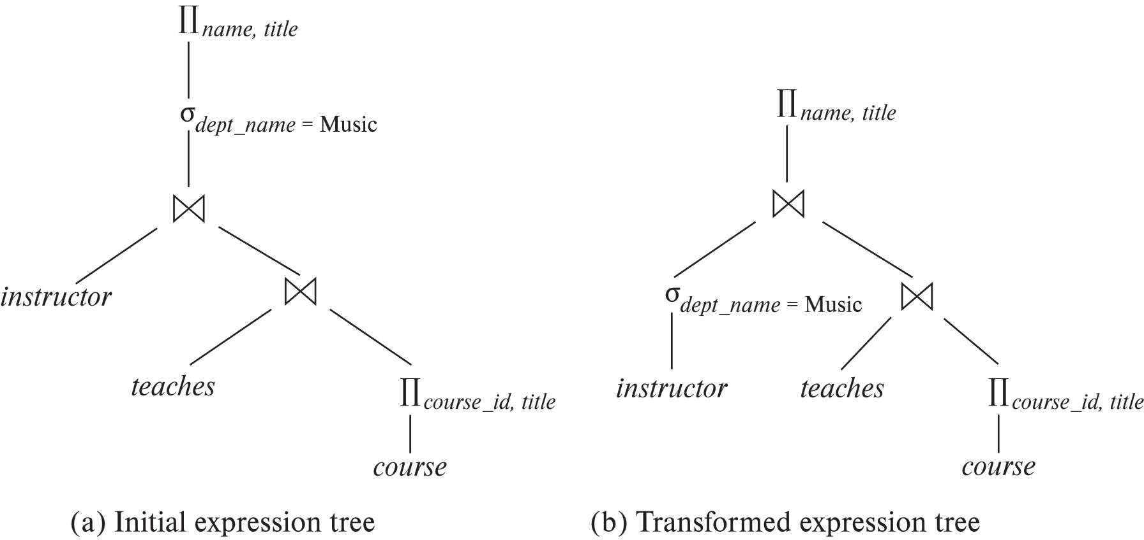
Introduction
Find the names of all instructors in the Music department together with the course title of all the courses that the instructors teach.
Alternative ways of evaluating a given query
Equivalent expressions
Different algorithms for each operation

Slide 4
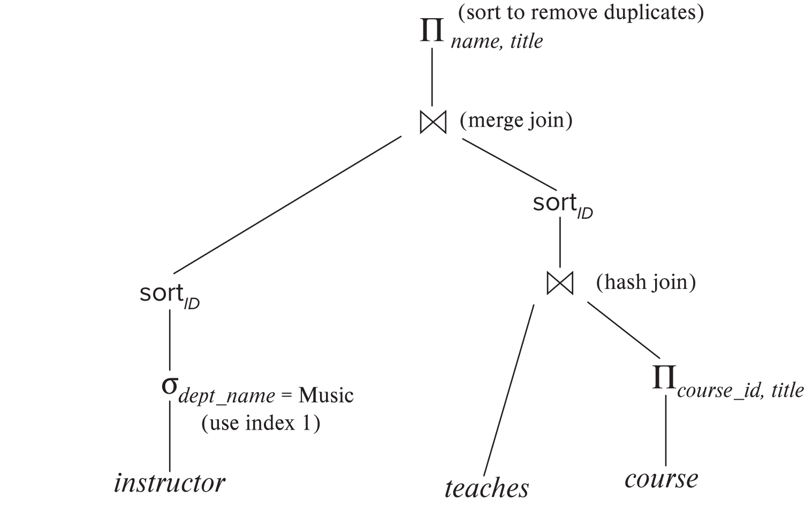
Introduction (Cont.)
An evaluation plan defines exactly what algorithm is used for each operation, and how the execution of the operations is coordinated.
Find out how to view query execution plans on your favorite database

Slide 5
Introduction (Cont.)
Cost difference between evaluation plans for a query can be enormous
E.g., seconds vs. days in some cases
Steps in cost-based query optimization
1. Generate logically equivalent expressions using equivalence rules
2. Annotate resultant expressions to get alternative query plans
3. Choose the cheapest plan based on estimated cost
Estimation of plan cost based on:
Statistical information about relations. Examples:
number of tuples, number of distinct values for an attribute
Statistics estimation for intermediate results
to compute cost of complex expressions
Cost formulae for algorithms, computed using statistics

Slide 6
Generating Equivalent Expressions

Slide 7
Transformation of Relational Expressions
Two relational algebra expressions are said to be equivalent if the two expressions generate the same set of tuples on every legal database instance
Note: order of tuples is irrelevant
we don’t care if they generate different results on databases that violate integrity constraints.
In SQL, inputs and outputs are multisets of tuples
Two expressions in the multiset version of the relational algebra are said to be equivalent if the two expressions generate the same multiset of tuples on every legal database instance.
An equivalence rule says that expressions of two forms are equivalent
Can replace expression of first form by second, or vice versa

Slide 8
Equivalence Rules
Conjunctive selection operations can be deconstructed into a sequence of individual selections. σ_{θ1 ∧ θ2} (E) ≡ σ_{θ1} (σ_{θ2} (E))
Selection operations are commutative. σ_{θ1}(σ_{θ2}(E)) ≡ σ_{θ2} (σ_{θ1}(E))
Only the last in a sequence of projection operations is needed, the others can be omitted. ∏ _{L1}(∏ _{L2}(…(∏ _{Ln}(E))…)) ≡ ∏ _{L1}(E) where L₁ ⊆ L₂ … ⊆ L_{n}
4. Selections can be combined with Cartesian products and theta joins.
σ_{θ} (E₁ x E₂) ≡ E₁ ⨝ _{θ} E₂
σ _{θ1} (E₁ ⨝_{θ2} E₂) ≡ E₁ ⨝ _{θ1∧θ2} E₂

Slide 9
Equivalence Rules (Cont.)
5. Theta-join operations (and natural joins) are commutative. E₁ ⨝ E₂ ≡ E₂ ⨝ E₁
6. (a) Natural join operations are associative:
(E₁ ⨝ E₂) ⨝ E₃ ≡ E₁ ⨝ (E₂ ⨝ E₃) (b) Theta joins are associative in the following manner: (E₁ ⨝ _{θ1} E₂) ⨝ _{θ2 ∧ θ3} E₃ ≡ E₁ ⨝_{θ1 ∧ θ3} (E₂ ⨝ _{θ2} E₃) where θ₂ involves attributes from only E₂ and E₃.

Slide 10
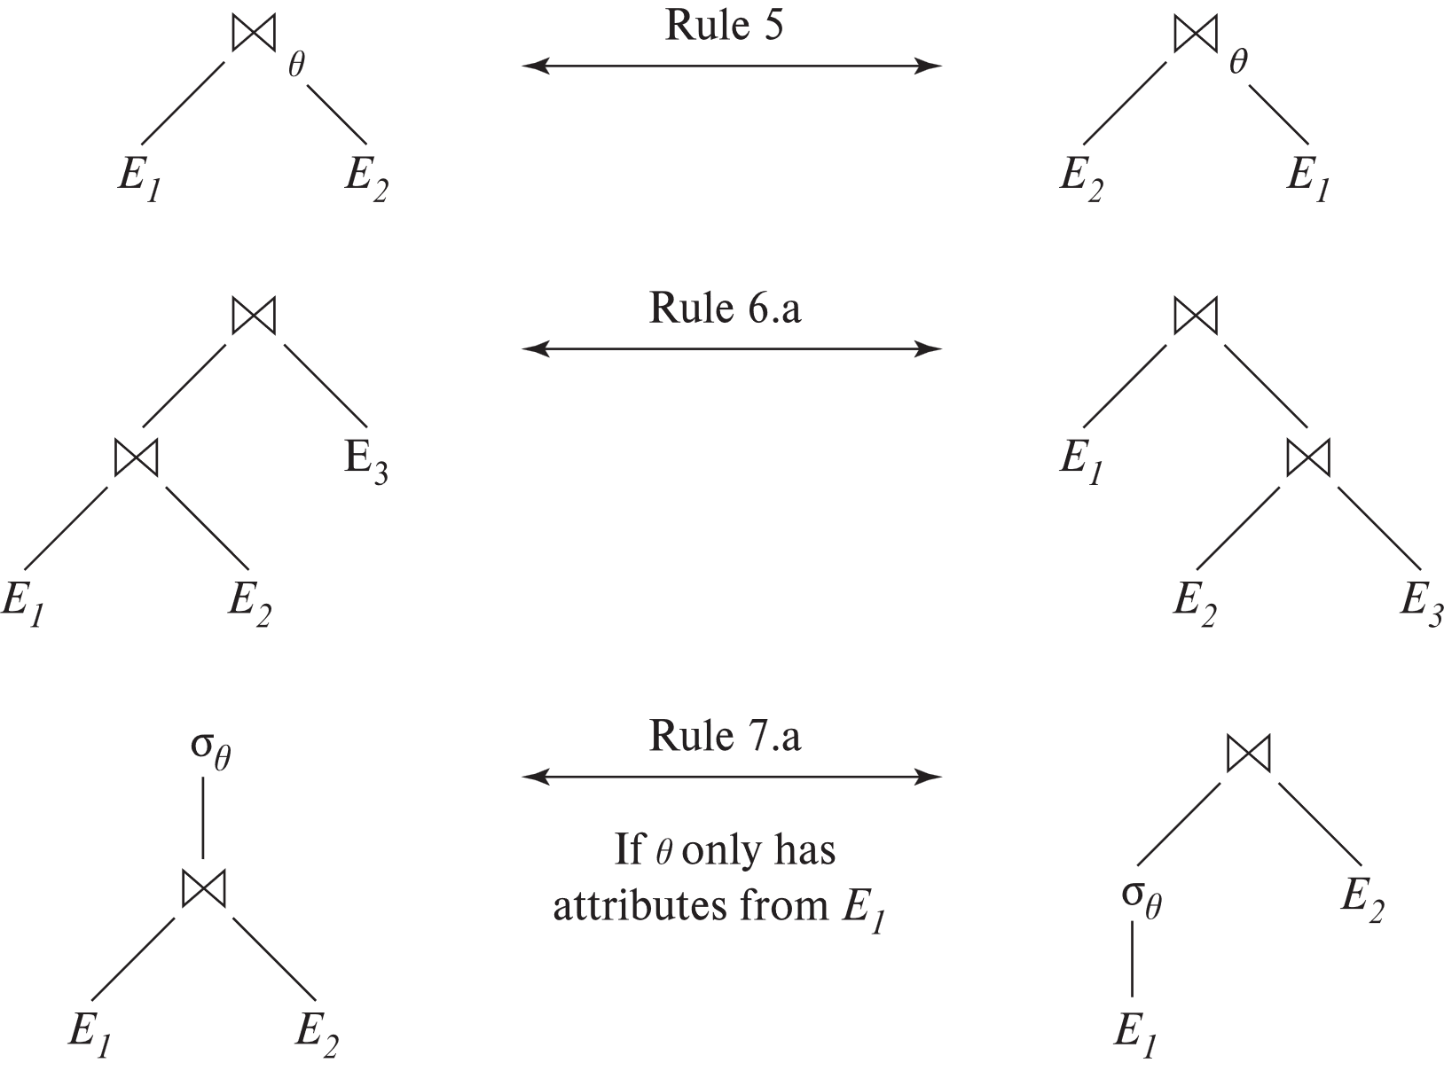
Pictorial Depiction of Equivalence Rules

Slide 11
Equivalence Rules (Cont.)
The selection operation distributes over the theta join operation under the following two conditions:
(a) When all the attributes in θ₀ involve only the attributes of one of the expressions (E₁) being joined. σ_{θ0} (E₁ ⨝_{θ} E₂) ≡ (σ_{θ0}(E₁)) ⨝_{θ} E₂
(b) When θ₁ involves only the attributes of E₁ and θ₂ involves only the attributes of E₂.
σ_{θ1 ∧ θ2} (E₁ ⨝_{θ} E₂) ≡ (σ_{θ1}(E₁)) ⨝_{θ} (σ_{θ2}(E₂))

Slide 12
Equivalence Rules (Cont.)
8. The projection operation distributes over the theta join operation as follows:
(a) if θ involves only attributes from L₁ ∪ L₂: ∏ _{L1 ∪ L2}(E₁ ⨝_{θ} E₂) ≡ ∏ _{L1}(E₁) ⨝_{θ} ∏ _{L2}(E₂)
(b) In general, consider a join E₁ ⨝_{θ} E₂.
Let L₁ and L₂ be sets of attributes from E₁ and E₂, respectively.
Let L₃ be attributes of E₁ that are involved in join condition θ, but are not in L₁ ∪ L₂, and
Let L₄ be attributes of E₂ that are involved in join condition θ, but are not in L₁ ∪ L₂.
∏ _{L1 ∪ L2}(E₁ ⨝_{θ} E₂) ≡ ∏ _{L1 ∪ L2}(∏ _{L1 ∪ L3}(E₁) ⨝_{θ} ∏ _{L2 ∪ L4}(E₂))
Similar equivalences hold for outerjoin operations: ⟕, ⟖, and ⟗

Slide 13
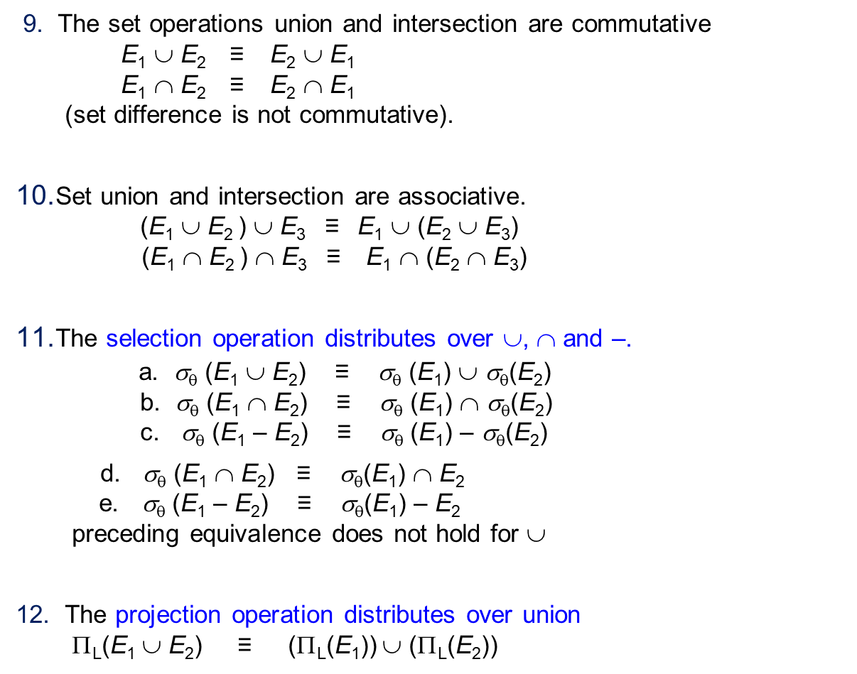
Equivalence Rules (Cont.)
9. The set operations union and intersection are commutative E₁ ∪ E₂ ≡ E₂ ∪ E₁ E₁ ∩ E₂ ≡ E₂ ∩ E₁ (set difference is not commutative).
Set union and intersection are associative. (E₁ ∪ E₂ ) ∪ E₃ ≡ E₁ ∪ (E₂ ∪ E₃) (E₁ ∩ E₂ ) ∩ E₃ ≡ E₁ ∩ (E₂ ∩ E₃)
The selection operation distributes over ∪, ∩ and –. a. σ_{θ} (E₁ ∪ E₂) ≡ σ_{θ} (E₁) ∪ σ_{θ}(E₂) b. σ_{θ} (E₁ ∩ E₂) ≡ σ_{θ} (E₁) ∩ σ_{θ}(E₂) c. σ_{θ} (E₁ – E₂) ≡ σ_{θ} (E₁) – σ_{θ}(E₂)
d. σ_{θ} (E₁ ∩ E₂) ≡ σ_{θ}(E₁) ∩ E₂ e. σ_{θ} (E₁ – E₂) ≡ σ_{θ}(E₁) – E₂ preceding equivalence does not hold for ∪
12. The projection operation distributes over union Π_{L}(E₁ ∪ E₂) ≡ (Π_{L}(E₁)) ∪ (Π_{L}(E₂))

Slide 14
Equivalence Rules (Cont.)
Selection distributes over aggregation as below σ_{θ}(_{G}𝛾_{A}(E)) ≡ _{G}𝛾_{A}(σ_{θ}(E)) provided θ only involves attributes in G
a. Full outerjoin is commutative: E₁ ⟗ E₂ ≡ E₂ ⟗ E₁ b. Left and right outerjoin are not commutative, but: E₁ ⟕ E₂ ≡ E₂ ⟖ E₁
15. Selection distributes over left and right outerjoins as below, provided θ₁
only involves attributes of E₁ a. σ_{θ1} (E₁ ⟕_{θ} E₂) ≡ (σ_{θ1} (E₁)) ⟕_{θ} E₂ b. σ_{θ1} (E₁ ⟖_{θ} E₂) ≡ E₂ ⟕_{θ} (σ_{θ1} (E₁))
16. Outerjoins can be replaced by inner joins under some conditions
a. σ_{θ1} (E₁ ⟕_{θ} E₂) ≡ σ_{θ1} (E₁ ⨝_{θ} E₂) b. σ_{θ1} (E₁ ⟖_{θ} E₂) ≡ σ_{θ1} (E₁ ⨝_{θ} E₂) provided θ₁ is null rejecting on E₂

Slide 15
Equivalence Rules (Cont.)
Note that several equivalences that hold for joins do not hold for outerjoins
σ_{year=2017}(instructor ⟕ teaches) ≢ σ_{year=2017}(instructor ⨝ teaches)
Outerjoins are not associative (r ⟕ s) ⟕ t ≢ r ⟕ (s ⟕ t)
e.g. with r(A,B) = {(1,1), s(B,C) = { (1,1)}, t(A,C) = { }
Notes:
How about (r ⟕ s) ⟕ t vs (r ⟕ t) ⟕ s assuming r has common attributes with s and t? Hint: consider 2 cases where s and t have common attributes and those where they have no common attribute

Slide 16
Transformation Example: Pushing Selections
Query: Find the names of all instructors in the Music department, along with the titles of the courses that they teach
Π_{name, title}(σ_{dept_name= ‘Music’} (instructor ⨝ (teaches ⨝ Π_{course_id, title} (course))))
Transformation using rule 7a.
σ_{θ0} (E₁ ⨝_{θ} E₂) ≡ (σ_{θ0}(E₁)) ⨝_{θ} E₂
Π_{name, title}((σ_{dept_name= ‘Music’}(instructor)) ⨝ (teaches ⨝ Π_{course_id, title} (course)))
Performing the selection as early as possible reduces the size of the relation to be joined.

Slide 17
Example with Multiple Transformations
Query: Find the names of all instructors in the Music department who have taught a course in 2017, along with the titles of the courses that they taught
Π_{name, title}(σ_{dept_name= "Music”∧year = 2017} (instructor ⨝ (teaches ⨝ Π_{course_id, title} (course))))
Transformation using join associatively (Rule 6a):
(E₁ ⨝ E₂) ⨝ E₃ ≡ E₁ ⨝ (E₂ ⨝ E₃) Π_{name, title}(σ_{dept_name= “Music”∧year = 2017} ((instructor ⨝ teaches) ⨝ Π_{course_id, title} (course)))
(Rule 7b): σ_{θ1 ∧ θ2} (E₁ ⨝_{θ} E₂) ≡ (σ_{θ1}(E₁)) ⨝_{θ} (σ_{θ2}(E₂))
provides an opportunity to apply the “perform selections early” rule,
resulting in the subexpression
σ_{dept_name = “Music”} (instructor) ⨝ σ _{year = 2017} (teaches)

Slide 18
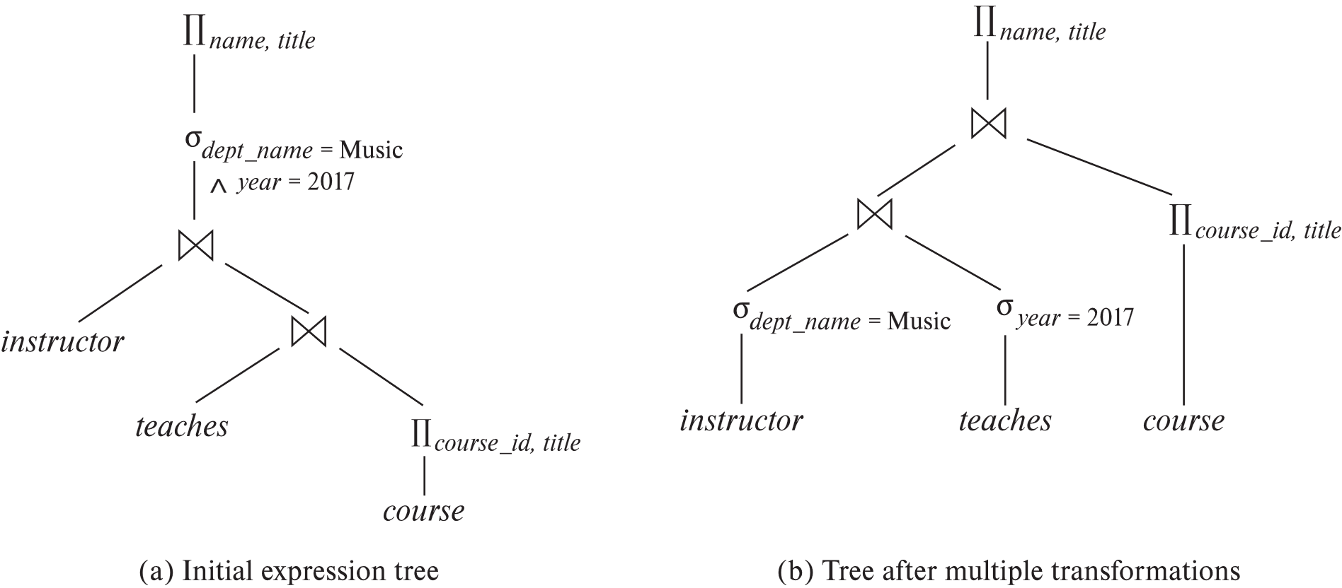
Multiple Transformations (Cont.)

Slide 19
Transformation Example: Pushing Projections
Consider: Π_{name, title}(σ_{dept_name= “Music”} (instructor) ⨝ teaches) ⨝ Π_{course_id, title} (course))))
When we compute
(σ_{dept_name = “Music”} (instructor ⨝ teaches)
we obtain a relation whose schema is: (ID, name, dept_name, salary, course_id, sec_id, semester, year)
Push projections using equivalence rules 8a and 8b; eliminate unneeded attributes from intermediate results to get:
∏ _{L1 ∪ L2}(E₁ ⨝_{θ} E₂) ≡ ∏ _{L1 ∪ L2}(∏ _{L1 ∪ L3}(E₁) ⨝_{θ} ∏ _{L2 ∪ L4}(E₂))
Π_{name, title}(Π_{name, course_id} ( σ_{dept_name= “Music”} (instructor) ⨝ teaches)) ⨝ Π_{course_id, title} (course))))
Performing the projection as early as possible reduces the size of the relation to be joined.

Slide 20
Join Ordering Example
For all relations r_{1,} r_{2,} and r₃,
(r₁ ⨝ r₂) ⨝ r₃ = r₁ ⨝ (r₂ ⨝ r₃ )
(Join Associativity) ⨝
If r₂ ⨝ r₃ is quite large and r₁ ⨝ r₂ is small, we choose
(r₁ ⨝ r₂) ⨝ r₃
so that we compute and store a smaller temporary relation.

Slide 21
Join Ordering Example (Cont.)
Consider the expression
Π_{name, title}(σ_{dept_name= “Music”} (instructor) ⨝ teaches) ⨝ Π_{course_id, title} (course))))
Could compute teaches ⨝ Π_{course_id, title} (course) first, and join result with σ_{dept_name= “Music”} (instructor) but the result of the first join is likely to be a large relation.
Only a small fraction of the university’s instructors are likely to be from the Music department
it is better to compute
σ_{dept_name= “Music”} (instructor) ⨝ teaches first.

Slide 22
Enumeration of Equivalent Expressions
Query optimizers use equivalence rules to systematically generate expressions equivalent to the given expression
Can generate all equivalent expressions as follows:
Repeat
apply all applicable equivalence rules on every subexpression of every equivalent expression found so far
add newly generated expressions to the set of equivalent expressions
Until no new equivalent expressions are generated above
The above approach is very expensive in space and time
Two approaches
Optimized plan generation based on transformation rules
Special case approach for queries with only selections, projections and joins

Slide 23
Cost-Based Optimization
Consider finding the best join-order for r₁ ⨝ r₂ ⨝ . . . ⨝ r_{n}.
There are (2(n – 1))!/(n – 1)! different join orders for above expression. With n = 7, the number is 665280, with n = 10, the number is greater than 176 billion!
No need to generate all the join orders. Using dynamic programming, the least-cost join order for any subset of {r₁, r₂, . . . r_{n}} is computed only once and stored for future use.

Slide 24
Cost Based Optimization with Equivalence Rules
Physical equivalence rules allow logical query plan to be converted to physical query plan specifying what algorithms are used for each operation.
Efficient optimizer based on equivalent rules depends on
A space efficient representation of expressions which avoids making multiple copies of subexpressions
Efficient techniques for detecting duplicate derivations of expressions
A form of dynamic programming based on memoization, which stores the best plan for a subexpression the first time it is optimized, and reuses in on repeated optimization calls on same subexpression
Cost-based pruning techniques that avoid generating all plans
Pioneered by the Volcano project and implemented in the SQL Server optimizer

Slide 25
Structure of Query Optimizers
Many optimizers considers only left-deep join orders.
Plus heuristics to push selections and projections down the query tree
Reduces optimization complexity and generates plans amenable to pipelined evaluation.
Heuristic optimization used in some versions of Oracle:
Repeatedly pick “best” relation to join next
Starting from each of n starting points. Pick best among these
Intricacies of SQL complicate query optimization
E.g., nested subqueries

Slide 26
Structure of Query Optimizers (Cont.)
Some query optimizers integrate heuristic selection and the generation of alternative access plans.
Frequently used approach
heuristic rewriting of nested block structure and aggregation
followed by cost-based join-order optimization for each block
Some optimizers (e.g. SQL Server) apply transformations to entire query and do not depend on block structure
Optimization cost budget to stop optimization early (if cost of plan is less than cost of optimization)
Plan caching to reuse previously computed plan if query is resubmitted
Even with different constants in query
Even with the use of heuristics, cost-based query optimization imposes a substantial overhead.
But is worth it for expensive queries
Optimizers often use simple heuristics for very cheap queries, and perform exhaustive enumeration for more expensive queries

Slide 27
End of Chapter

